Slide 1
PROGRAM PORTFOLIO & REVENUE INTELLIGENCE
Weeks 1–3 Recap
From Raw Data to an Interactive Dashboard
Team 11
Data Visualization Trainee Internship · Excelerate Analytics Suite

Slide 2




Agenda
01
Week 1 — Data Preparation
Cleaning, documentation, and a reliable foundation dataset
02
Week 2 — Exploratory Analysis
Trends, patterns, and an honest look at data limitations
03
Week 3 — Interactive Dashboard
Turning analysis into a live, filterable executive view
04
Lessons & Next Steps
What we'd improve, and where this goes from here
Team 11 · Data Visualization Trainee Internship
2

Slide 3




WEEK 1
Data Preparation
5,733 → 5,674
33 → 45
59
Deliverables
Data Dictionary
Rows (raw → cleaned)
Columns (raw → cleaned)
Corrupted/unusable records removed
45 fields documented end-to-end
Key cleaning actions
Cleaning Documentation
Every transformation explained
Converted timestamps from raw Unix milliseconds to readable dates
Standardized duration into one unit (duration_standard_days)
Team Charter
Flattened 10 nested JSON fields into clean reference IDs
Roles, norms, and workflow
Standardized currency and location labels; removed corrupted rows
Outcome: an analysis-ready dataset — standardized, structured, and prepared for Week 2 EDA & dashboards.
Team 11 · Data Visualization Trainee Internship
3

Slide 4




WEEK 2
Exploratory Data Analysis
4 required analyses, plus 7 supplementary deep-dives
Sign-up trends
Applications by location
Outreach channel performance
Scholarship distribution
Headline findings
Seasonal posting cycle
$120 near-universal scholarship
Postings spike around academic intake windows (Jul, Oct/Nov, Feb/Mar), not a steady stream
86.2% of opportunities carry the same token scholarship amount
210-day duration template
Duration ↔ Reward correlation
Most programs cluster around a ~7-month standard length
r = -0.48 — shorter opportunities are more likely to carry a reward
Team 11 · Data Visualization Trainee Internship
4

Slide 5


Where the data couldn't take us
Two of the four required Week 2 analyses couldn't be completed as originally scoped — and we chose to document that gap rather than fabricate a result.
Applications by Location
Outreach Channel Performance
This dataset is opportunity-level, not applicant-level — there is no field recording where applicants are based.
No field tracks acquisition channel. We can show posting delivery format (Virtual/WFH), but not how applicants found us.
Team 11 · Data Visualization Trainee Internship
5

Slide 6
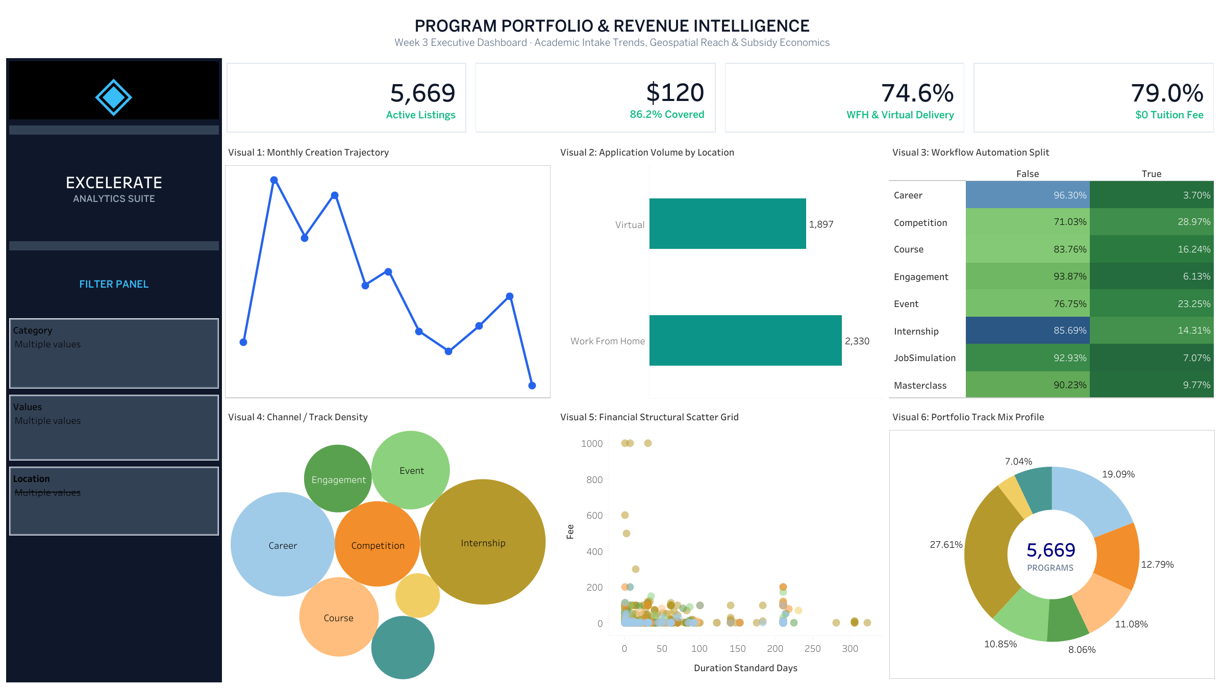

WEEK 3
The Interactive Dashboard
At a glance
4 KPI cards + 6 visuals
Top row KPIs → middle grid (operational dynamics) → bottom grid (qualitative concentrations)
Dataset
cleaned_opportunities.csv, built in Tableau Public
Filters
Category (Inclusive) · Location (Exclusive) · Values (Inclusive)
No cross-visual highlight actions yet — flagged for a future iteration.
Team 11 · Data Visualization Trainee Internship
6

Slide 7
The 6 Visuals — Quick Reference
1
Monthly Creation Trajectory
Erratic peaks & drops — reactive, not planned
2
Volume by Delivery Format
WFH (2,330) + Virtual (1,897) dominate
3
Workflow Automation Split
Career 3.70% · Engagement 6.13% · Competitions 28.97% automated
4
Category Track Density
Internships 27.61% · Career 19.09%
5
Financial Structural Scatter
Short programs = higher fees (up to $1,000); long = mostly free
6
Portfolio Track Mix Profile
Confirms track composition alongside Visual 4
Team 11 · Data Visualization Trainee Internship
7

Slide 8
WEEK 3
Key Dashboard Insights
74.6%
86.2%
79.0%
Delivery is Work From Home or Virtual
Of opportunities carry scholarship coverage
Of opportunities are $0 tuition
Counter-intuitive finding: shorter programs cost more
Premium fees (up to $1,000) cluster among programs under 30 days — not long-duration ones. 200–320 day programs average under $3 (r = -0.10, weak negative).
Category mix: Internship (27.6%) and Career (19.1%) lead the portfolio — together, roughly half of all listings.
Team 11 · Data Visualization Trainee Internship
8

Slide 9
Critical Risks & Operational Bottlenecks
Manual workload by category
Critical Risks
Career
96.30%
Engagement
93.87%
Timeline Volatility
Erratic creation cycle suggests reactive, not planned, development
Job Simulations
92.93%
Masterclasses
90.23%
Underutilized Automation
Competitions (best, still low)
71.03%
High-touch categories are missing clear streamlining opportunities
% manual (not automated) — even the best category is still mostly manual
No Applicant-Level Data
Demand cannot yet be confirmed to match supply
Team 11 · Data Visualization Trainee Internship
9

Slide 10
Challenges & Data Quality Decisions
Every exclusion we made was deliberate — and documented, not hidden.
Corrupted rows
Placeholder test text
A handful of rows had JSON fragments spilled into the wrong columns — isolated and removed.
Junk location values (e.g. lorem-ipsum strings) flagged rather than silently counted as real data.
Inconsistent units
Rare categories
Duration units (week/weeks, month/months) and currency labels (EUR/EURO) standardized.
Program & Xploreu (4 records) excluded from dashboard metrics, with a visible footnote explaining why.
Team 11 · Data Visualization Trainee Internship
10

Slide 11
Phased Strategic Roadmap
Recommendations for the program sponsor, based on dashboard findings
Phase 1
Phase 2
Phase 3
Automation & Scalability
Portfolio Optimization
Financial & Resource Reallocation
1–3 months
3–6 months
6+ months
Automate Career & Engagement tracks
Move to a standardized quarterly release schedule
Direct subsidies toward tracks with clear professional outcomes
Launch automated grading, self-paced modules
Package top virtual programs into flexible, async formats
Expand short-form, higher-fee offerings to fund the 79% free programs
Instant enrollment notifications
Team 11 · Data Visualization Trainee Internship
11

Slide 12
Bottom Line
✓
Scale
5,669 listings
✓
Accessibility
79% free, $120 average subsidy
✓
Delivery
74.6% digital
✗
Operations
Manual workflows blocking scale
✗
Planning
Volatile, reactive timeline
Next step: Automate high-volume tracks → stabilize release cycle → monetize short-form premium offerings.
Team 11 · Data Visualization Trainee Internship
12

Slide 13
Lessons Learned & Team Process
How we split the work
What we'd do differently
Team Lead
Coordination, QA, and final review
Agree on one cleaning script earlier — we had two versions diverge mid-week
Data Cleaning
Power Query + Python cleaning pipeline
Add dashboard footnotes for filtered/excluded data from the start
Dashboard Build
Tableau Public development
Build cross-visual filtering into the dashboard, not just quick filters
TOOLS USED
Power Query · Python · Tableau Public ·
Team 11 · Data Visualization Trainee Internship
13

Slide 14
Thank You
Questions & Discussion
Team 11 · Data Visualization Trainee Internship
14

